Slide 1
What OSHA is Looking for During an Inspection
Presented by
Ed Grzybowski
Grizzly bear safety & security consultants™, llc

Slide 2
DISCLAIMER
The information in this presentation is intended to furnish users with general information regarding OSHA inspection methodologies and employer rights and responsibilities regarding them. The information contained in this presentation is provided by Grizzly Bear Safety and Security Consultants, LLC for general guidance and is not intended to replace or serve as substitute for any audit, advisory, tax or other professional advice, consultation, or service. You should consult with the appropriate Grizzly Bear Safety and Security professionals or other professional advisers for advice concerning specific safety program or other matters before making any decision
The opinions expressed in this presentation are of those of the author. They do not purport to reflect the opinions or views of the US Department of Labor, OSHA, or any other entity. The information presented is based upon the best publicly available information available at the time of presentation.
This presentation contains links to third-party websites or content. These links are provided for convenience only, and Grizzly Bear Safety & Security Consultants, LLC does not endorse, warrant, or assume liability for the content or practices of these third-party sites.
All content, including text, images, logos, and graphics, in this presentation is the property of Grizzly Bear Safety & Security Consultants, LLC and is protected by applicable copyright and intellectual property laws.

Slide 3
Terminal Learning Objective Participants will be able to:
Apply an understanding of the procedures during and after an OSHA inspection in order to protect their employer’s rights during an inspection and to minimize the impact of such inspections.

Slide 4
Enabling Learning Objectives Participants will be able to describe:
Common reasons for an OSHA inspection (triggers) and types of OSHA inspections.
The elements of an OSHA inspection and the normal progression of an inspection
An employer’s rights and responsibilities during and following an OSHA inspection, how to avoid and prepare for OSHA inspections, and common affirmative defenses for OSHA citations.

Slide 5
Inspection Triggers and Types Complaints
Formal Complaint
Signed by Employee/Representative
Employee/Representative Any other person acting in a bona fide representative capacity, including, but not limited to, members of the clergy, social workers, spouses and other family members, and government officials or nonprofit groups and organizations acting upon specific complaints and injuries from individuals who are employees
Informal Complaint
Not signed/Anonymous
Allegation of imminent Danger
Allegation of hazard associated with NEP/LEP.
Unsatisfactory Employer response to inquiry.
Employer has a history

Slide 6
Inspection Triggers and Types Referrals
Other Agencies (FD, PD, Media)
CSHO Referrals

Slide 7
Inspection Triggers and Types Incidents
Within 8 hours
Fatality
Within 24 hours
Hospitalization
Amputation
Loss of an Eye
Failure to Report an Incident
The BEST way to report is online: Report a Fatality or Severe Injury

Slide 8
Inspection Triggers and Types Programmed
National Emphasis Programs (NEPs)
Regional/Local Emphasis Programs (REPs/LEPs)
National Guidance (National Office Memos)

Slide 9
Inspection Types
Programmed
Inspection based upon pre-existing criteria/schedule.
Unprogrammed
Inspection based upon receipt of information that requires an inspection to resolve/answer
Most OSHA offices will have both types. The mix will depend on the location/geography

Slide 10
Programmed Inspection Triggers National Emphasis Programs (NEPs)
CPL 03-00-024 - Outdoor and Indoor Heat-Related Hazards
“ … to increase the likelihood of preventing heat-related illnesses and deaths and make efficient use of OSHA resources, compliance safety and health officers (CSHOs) who are investigating for other purposes, shall open or refer a heat-related inspection for any hazardous heat conditions observed …”
CPL-02-00-161 - National Emphasis Program on Trenching and Excavation
“…Compliance Safety and Health Officers (CSHOs) shall initiate inspections under this NEP whenever they observe an open trench or an open excavation, regardless of whether or not a violation is readily observed. These observations may occur during the course of their normal work-day travel or while engaged in programmed or un-programmed inspections…”

Slide 11
Programmed Inspection Triggers Regional & Local Emphasis Programs
CPL 23/11 (CPL 04), Local Emphasis Program for Construction, 4/18/2023 (R4)
“… Due to the mobility of employers in the construction industry, the transitory nature of construction sites and the fact that sites often involve more than one employer, inspections shall be scheduled from a list of work sites (Appendices A, B, and C) rather than employers…”
CPL-04-00-024G, Local Emphasis Program for Noise in the Workplace, 10/1/2019 (R1)
“… The Directorate of Technical Support and Emergency Management (DTSEM), Office of Statistical Analysis (OSA) will generate a master list of establishments in the targeted NAICS codes within Region 1 and then assign a random number to each establishment. …”

Slide 12
Programmed Inspection Triggers National Guidance Memos
OSHA Memorandum, Subject: Enforcement Procedures for Failure to Submit Electronic Illness and Injury Records under 29 CFR 1904.41(a)(1) and (a)(2), 5/6/2021
“Compliance safety and health officers (CSHOs) should refer to this database during all inspections to identify employers that were required to submit records¹ but failed to do so. Employers shall not be cited for failure to submit records by March 2, provided the employer attempted to submit its records but was unable to do so due to performance problems associated with the ITA. The data must have been submitted, however, in a timely fashion once the ITA becomes operational. Area Directors may direct CSHOs to perform a full recordkeeping audit where there is evidence of potential systemic recordkeeping issues.”

Slide 13
Inspection Elements and Progression Day of the inspection
Arrival
Opening Conference
Walk-Around
Interviews
Document Requests
Closing Conference “1”

Slide 14
Inspection Elements and Progression Subsequent/Follow on Visit(s)
Why?
How many?
Frequency?
Duration

Slide 15
Inspection Elements and Progression Closing of the Inspection
Not required. You do not have to have one.
Closing Conference “2”
Who can/should/must attend
What will be discussed

Slide 16
Inspection Elements and Progression Citation Issuance
Citations are for the presence of hazards – not an incident
Each citation must establish that the cited standard applied, the standard was violated, employees were exposed, and the employer had knowledge of the hazard
Citation Timeliness
Sent by Certified Mail
Must be mailed within 180 days of any cited exposure incident

Slide 17
Inspection Elements and Progression Types of Citations
General Duty Clause 5(a)(1)
Other Than Serious
Serious
Willful
Failure to Abate
Repeat
Criminal Referrals

Slide 18
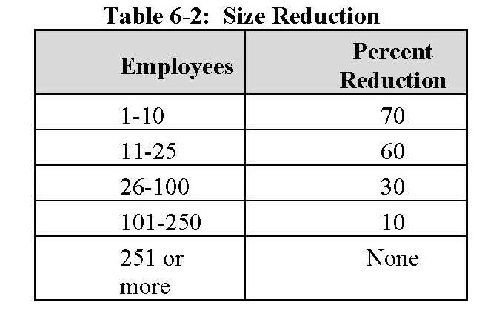
Employer Rights & Responsibilities Citation Calculations are based upon:
Gravity
Company Size
Severity
High
Medium
Low
Minimal
Probability
Greater
Lesser
Source: CPL 02-00-164 - Field Operations Manual

Slide 19
Employer Rights & Responsibilities Citation Calculations are based upon:
History
Good Faith
25% Reduction – written SHMS
15% Reduction – documented with minor issues
10% reduction if no inspections
or serious violations in last 5 years
10% increase if high gravity issued
with Final order in last 5 years
CPL 02-00-164 - Field Operations Manual

Slide 20
Employer Rights & Responsibilities Citation Calculations are based upon:
Repeat
Small Employer (<250) 2/5 multiple
Large Employer (>250) 5/10 multiple
Willful
Failure to Abate
Original penalty X # of calendar days (up to 30x)

Slide 21
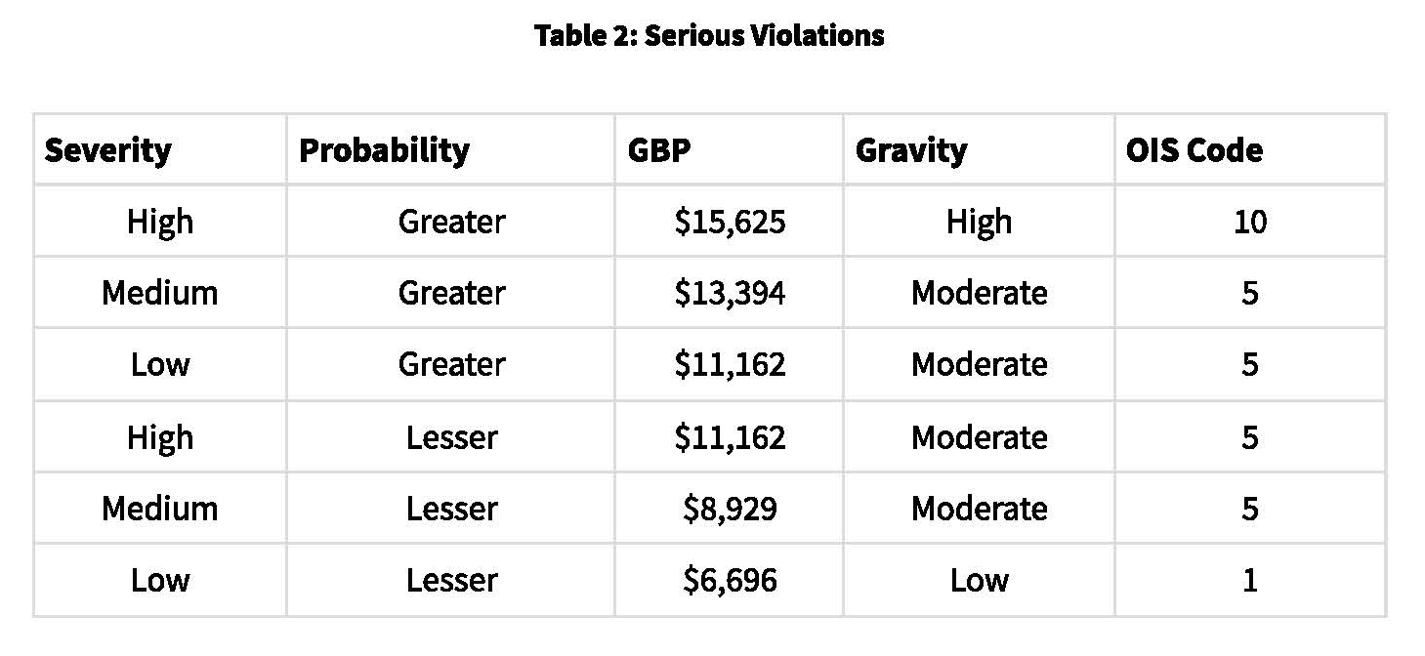
Employer Rights & Responsibilities Citation Calculations are based upon:
Source: 2023 Annual Adjustments to OSHA Civil Penalties

Slide 22
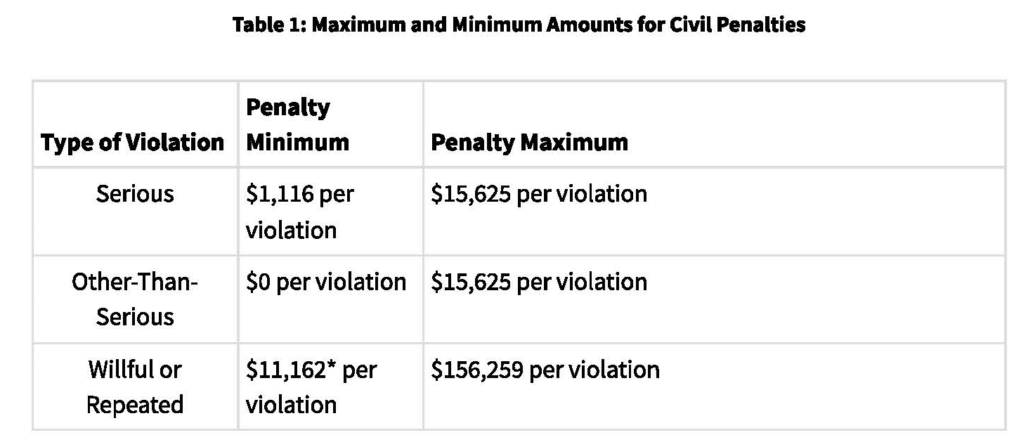
Employer Rights & Responsibilities Citation Calculations are based upon:
Source: 2023 Annual Adjustments to OSHA Civil Penalties

Slide 23
Inspection Elements and Progression The Informal Conference
To have one or not to have one?
How to schedule?
When to schedule
Do I have to go to the OSHA office?
Who should attend?

Slide 24
Inspection Elements and Progression The Informal Conference
What do I need?
Affirmative Defenses
Evidence
What to expect?
If Agreement is reached, then both parties will sign a settlement agreement
When signed, the agreement amends any citations and becomes a Final Order

Slide 25
Inspection Elements and Progression Contest/Litigation
Must file within 15 working days of citation issuance
Cannot file contest and also have an informal conference
Can be submitted by the company or legal counsel
Must identify what you are contesting
How to submit
The Area Office will submit to the OSHRC

Slide 26
Inspection Elements and Progression Contest/Litigation
OSHRC will get the case on the Docket
Company/Counsel will be notified by OSHRC
DOL Solicitor’s Office will contact the employer
Attempt to reach agreement
Otherwise Hearing by Administrative Law Judge
Appeal to the OSHRC

Slide 27
Employer Rights & Responsibilities At the Inspector’s Arrival
Inspector must provide valid credentials
Inspector can challenge the inspector’s identity
Inspector must provide the allegations
Employer can deny entry
Employer can have legal counsel present
Employer can delay the opening of the inspection for up to one hour for attendees to arrive

Slide 28
Employer Rights & Responsibilities During the Walk-Around
Inspector must be escorted by the employer
Employer determines the route to the inspection site
Employer can accompany the inspector
Employer may have as many participants as desired provided they do not disrupt the inspection process
If a union facility, employer must allow a union/employee representative to attend the walk-around.

Slide 29
Employer Rights & Responsibilities Photographs
Inspector cannot provide his/her photographs to the employer
Employer may take pictures of the same thing(s) as the inspector
Employer may take pictures of the inspector taking pictures
Employer may record video and/or audio
Employer must take their own measurements
Employer does not need to provide measuring tools to the inspector.
Employer may deny the inspector permission to take a particular photo(s).
If inspector is taking video (e.g., a machine in operation) he may also capture audio of the participants talking.
Inspector may request copies of photos taken by the employer (e.g., accident scene)

Slide 30
Employer Rights & Responsibilities Protected/Privileged Information
Inspector will make a document request
This may be verbal at some point during the inspection
The inspector may provide a written request
This may be a paper copy of a list of documents
The inspector may email it to the employer
The employer does not need to provide any documents without a subpoena

Slide 31
Employer Rights & Responsibilities Proprietary Information & Trade Secrets
The inspector is not entitled to review any proprietary or trade secret information unless it is material to the inspection
If the inspector is to review and/or retain copies of such information, it must be properly marked and protected
The employer can deny photographs that include trade secret information (i.e. machines in the background)
Do not abuse the privilege of using these classifications.

Slide 32
Employer Rights & Responsibilities PII and HIPAA protections
The inspector is entitled to any information that is material to the inspection. This includes:
PII (name, position, contact information, date of hire) for any/all employees that would be involved in the inspection (i.e. individuals that use a particular machine or are part of a process, supervisors and/or managers of these individuals, witnesses, etc.)
HIPPA information as it pertains to the inspection and allegations (e.g. hearing test results, autopsy reports).
If the inspector is to review and/or retain copies of such information, it must be properly marked and protected

Slide 33
Employer Rights & Responsibilities Interviews
Manager. Managers are individuals who can represent the company to external third parties (e.g. vendors, media, etc.) As such, the employer is allowed to attend these interviews.
Supervisor. Supervisors are not necessarily managers in this context. Whether or not a supervisor is also a manager is situationally dependent.
Employee. The employer is not allowed to attend these interviews. However, if the employer’s legal counsel is also retained as the personal counsel for an employee, then counsel may be present. When this occurs, OSHA will require a waiver to be signed by the individual(s).

Slide 34
Employer Rights & Responsibilities Interviews
The inspector is entitled to interview individuals in private. Employers often provide an empty office/conference room for this purpose.
Anyone can refuse to be interviewed. They do not need to provide a reason. If the inspector considers the testimony of such an individual to be essential, then a subpoena can be issued.
Individuals who speak other languages (e.g. Spanish, Korean, etc.) can be interviewed in their native language.
The inspector will typically ask if the individual will sign a statement. The individual has the right to refuse to sign.

Slide 35
Employer Rights & Responsibilities Interviews
The individual is entitled to a copy of any statement made.
The inspector may interview individuals at the work place or elsewhere (e.g., home, restaurant, etc.) The inspector is not required to identify with whom they have spoken.
The inspector may interview other individuals (e.g. first responders, neighborhood residents, friends, relatives, etc.). The inspector is not required to inform the employer of these interviews.

Slide 36
Employer Rights & Responsibilities Required Citation Elements
Standard Applies
Standard Violated
Employee Exposure
Employer Knowledge

Slide 37
What Standard? 1910.141(d)(2)(ii) Each lavatory shall be provided with hot and cold running water, or tepid running water.
 | What do I have to prove | What is my proof?
1. Standard Applies | Employer has a lavatory | CSHO observation during walk-around
2. Standard Violated | It was not provided with hot and cold running water, or tepid running water | CSHO tested the water in the lavatory, and it was only provided cold water
3. Employee Exposure | The lavatory is used by employees | Interviews established that employees on all shifts used the lavatory CSHO observed employees entering/exiting the lavatory during the walk-around
4. Employer Knowledge | Shift manager is aware that the lavatory is being used without with hot and cold running water, or tepid running water | Interviews established that employees complained to the shift manager but nothing was done. Work order #1234 established that the lavatory was scheduled for repair 6 months ago, but it was not taken out of service.

Slide 38
Employer Rights & Responsibilities Common Affirmative Defenses
Employee Misconduct
Infeasibility
Greater Hazard

Slide 39
Misconduct Defense? 1910.147(d)(6) On or about 9/12/2023 in the manufacturing line #3 employees were exposed to amputation hazards from rotating equipment because they did not verify that isolation and deenergization of the machine or equipment had been accomplished prior to starting work on machines or equipment that had been locked out or tagged out.
 | What do I have to prove? | What is my proof?
1. ER has a Work Rule to enforce standard | Exposed employees had been trained and equipped to perform work tasks consistent with this standard. | Employer has a written LOTO program dated 1/3/2023 which requires that employees performing LOTO verify that that isolation and deenergization of the machine or equipment had been accomplished prior to starting work
2. ER has communicated the work rule to EEs | The employer had trained any/all exposed employees via online training and periodic inspection reviews. | The exposed employees had received training on 3/4/23 and passed the LOTO exam The energy control procedure for this machine specifies this requirement.
3. ER has means to identity infractions | Daily shift walk-through inspections have to be detailed and frequent enough to deter employees from violating safety rules. | Shift supervisors make routine walk-through inspections 3 times per shift. Supervisors complete a inspection checklist which is retained for two years.
4. ER applies disciplinary measures to enforce work rule | Any violation of this requirement results in automatic termination | HR disciplinary records for the last two years show that two employees were discharged for violating this rule.

Slide 40
Employer Rights & Responsibilities Do’s and Don’ts
Do not ever lie to an inspector
Do not provide any information not specifically asked for.
Do not let the inspector roam around. Do always escort him/her.
Do take your own pictures and measurements. Take pictures of the CSHO.
Do have more than one company representative present at all times.
Do take notes.

Slide 41
Employer Rights & Responsibilities Do’s and Don’ts
Do treat the inspector with professionalism and respect.
Do not offer any drinks or food (or anything else) They cannot accept it. Water is OK.
Do deny access/end the inspection if you feel it is warranted
If you have an incident (fatality, amputation, etc.) expect OSHA to arrive within 24 hours.
Do answer all complaint inquiries completely and on time.
Submit OSHA logs on time (as applicable).
Do always be ready for an inspection. Especially if you are in high hazard industries.

Slide 42
References:
CPL 02-00-164 - Field Operations Manual
CPL 03-00-024 - Outdoor and Indoor Heat-Related Hazards
CPL-02-00-161 - National Emphasis Program on Trenching and Excavation
OSHA Memorandum, Subject: Enforcement Procedures for Failure to Submit Electronic Illness and Injury Records under 29 CFR 1904.41(a)(1) and (a)(2), 5/6/2021

Slide 43
Contact Information
For more information or specific consultation:
Ed Grzybowski, MS, MBA, GSP
Grizzly Bear Safety & Security Consultants, LLC
EPGrzybowski@gmail.com
205-729-4600

Slide 44
Questions?

