Slide 1
The NLRB is Shaking Things Up! Labor law developments impacting all employers
Matthew Stiles, Esq.
Shareholder- Labor, Employment & Benefits
Mike Perkins
Chief of Staff
Mike Perkins, Esq.
Corporate Counsel

Slide 2
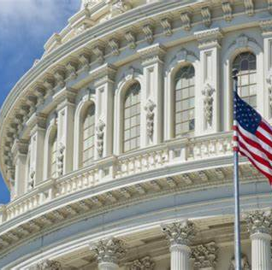
The National Labor Relations Board Who are These People and Why Should I Care?
What is the NLRB?
How many members?
How do they get there?
What do they do?
Who sets the agenda?

Slide 3
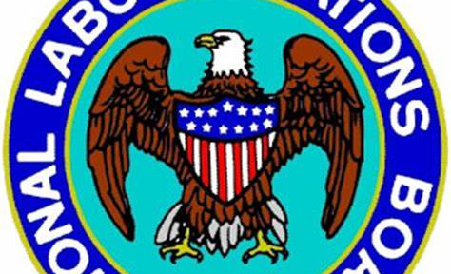
NLRB
What is the NLRB
National Labor Relations Board
Quasi-judicial body that decides cases and sets policies based on facts determined in administrative hearings by ALJs
Operates through 26 Regional Offices- Overseen by Regional Directors (Bd appoints)
Georgia is in Region 10- Atlanta, Birmingham, Nashville, Winston Salem
How many members?
5 members
Staggered 5-year terms
General Counsel- 4 yr term
How do they get there?
Presidential appointment with consent by Senate
3 by party in office (McFerran, Wilcox, Prouty)
Backgrounds in unions or representing unions
2 by minority party (Kaplan, VACANT-Ring term expired 12/22)
Backgrounds representing management

Slide 4
VACANT
Lauren McFerran (D)
Chair
Term ends December 16, 2024
John F. Ring (R) Member
Term ended December 16, 2022
David Prouty (D)
Member
Term ends August 27, 2026
The NLRB
Gwynne Wilcox (D)
Member
Term ends
August 27, 2028
Marvin E. Kaplan (R)
Member
Term ends August 27, 2025

Slide 5
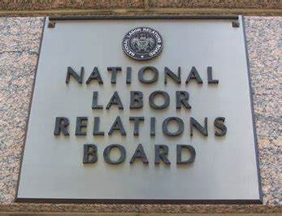
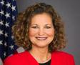
NLRB
What does it do?
Supervises labor union representation elections
Investigates and remedies unfair labor practice charges
Decides cases
Engages in rulemaking
Enforces orders through courts
Facilitates settlements
Who sets the agenda?
NLRB General Counsel- Jennifer Abruzzo
President Biden appointee
Special Counsel for Strategic Initiatives for Communications Workers of America
20 years as attorney with NLRB

Slide 6
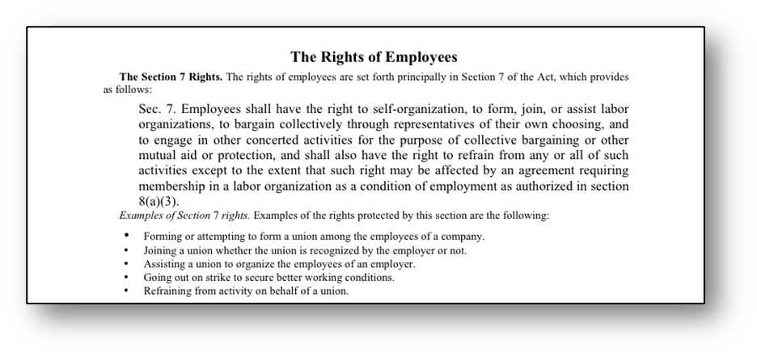
Employees shall have the right to self-organization, to form, join or assist labor organizations, to bargain collectively through representatives of their own choosing, and to engage in other concerted activities… and shall also have the right to refrain from any and all such activities….
29 U.S.C. §§ 151-169
Sec. 7 [§157]

Slide 7
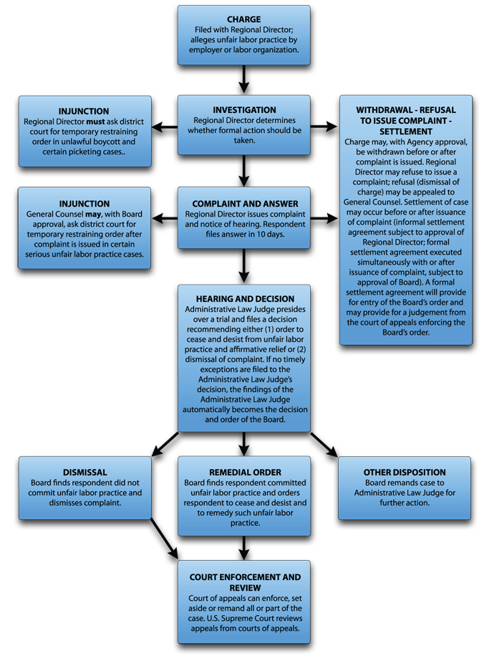
ULP Case Process
Charges filed by parties against unions or employers with appropriate regional office
The regional office investigates the complaint.
If a violation is believed to exist, the region will take the case before an Administrative Law Judge (ALJ) who will conduct a hearing
The decision of the ALJ may be reviewed by the NLRB Board
Board makes decisions that guide the regions in their approach to issues
Board decisions are reviewable by US Courts of Appeals
The Board's decisions are not self-executing: Can only be enforced through court action

Slide 8
2,000- 3,000 ULP Cases per year (most withdrawn, dismissed or settled) Approx 500 decisions YTD Full Board Decisions 80 Published 150 Unpublished
Source: lrirightnow.com

Slide 9
Certification Petitions Filed by Year
Source: lrirightnow.com

Slide 10
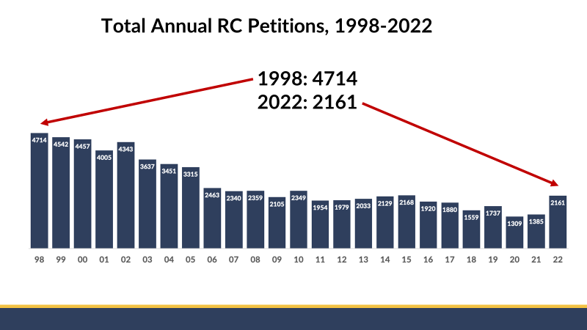
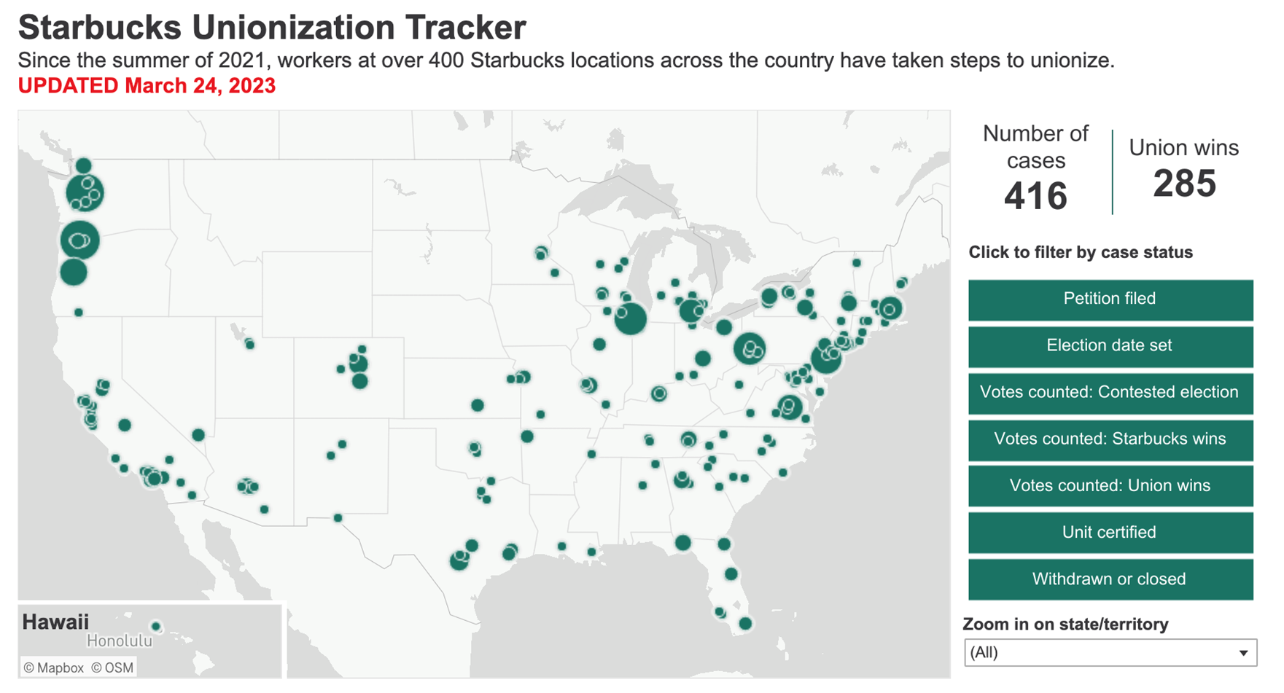
2022 Was a Busy Year for RCs
The “Starbucks Factor” is Significant

Slide 11
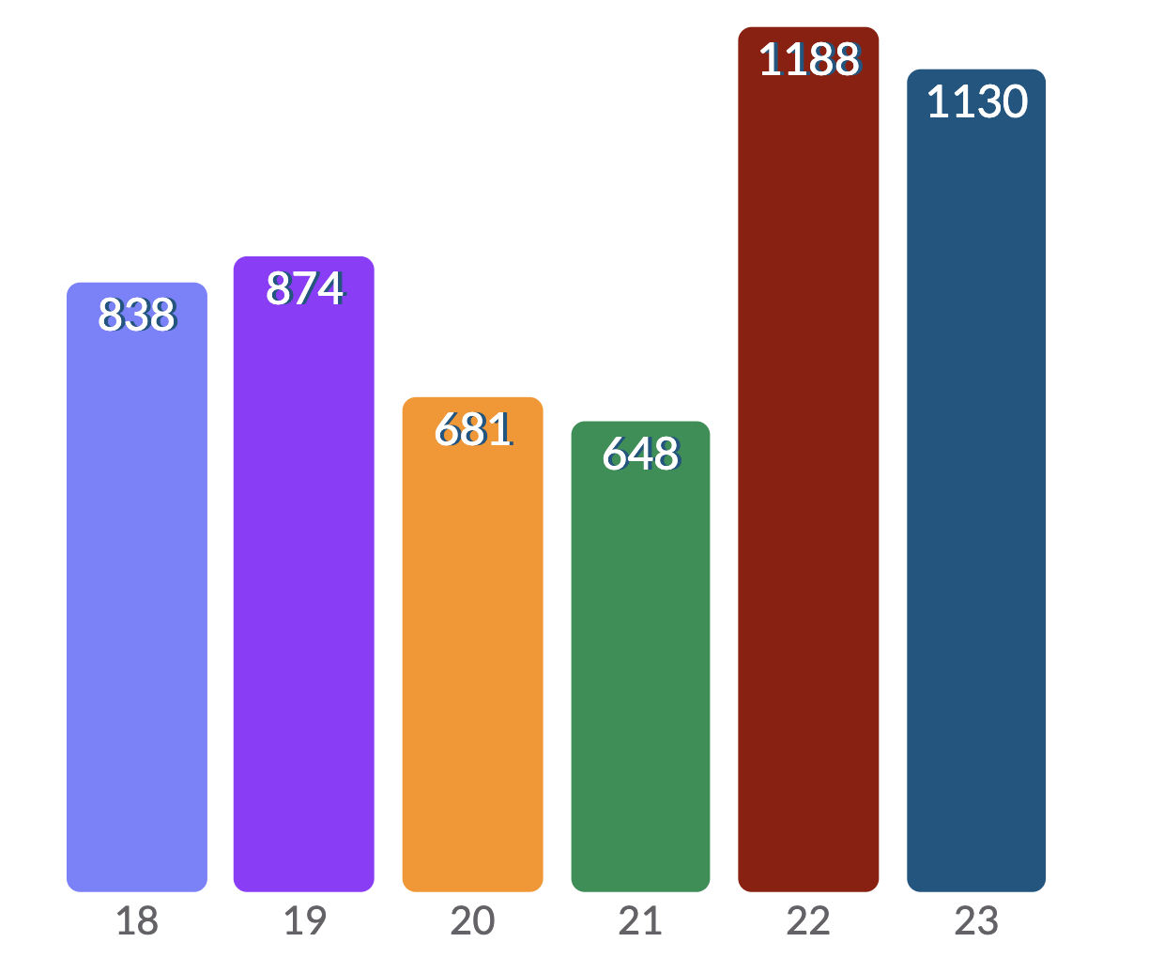
RC Petitions, First 6 months 2018-2023

Slide 12
Is Politics a Factor?

Slide 13
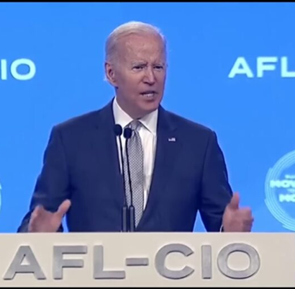
Joe Biden’s Labor Promise I’m going to hold company executives personally liable for interfering with workers who are attempting to unionize. It’s not enough just to have their corporations pay a fine. If they’re part of the problem, they are going to pay a personal price. “I’m going to be the strongest labor president you have ever had. - President Biden, September 7, 2020

Slide 14
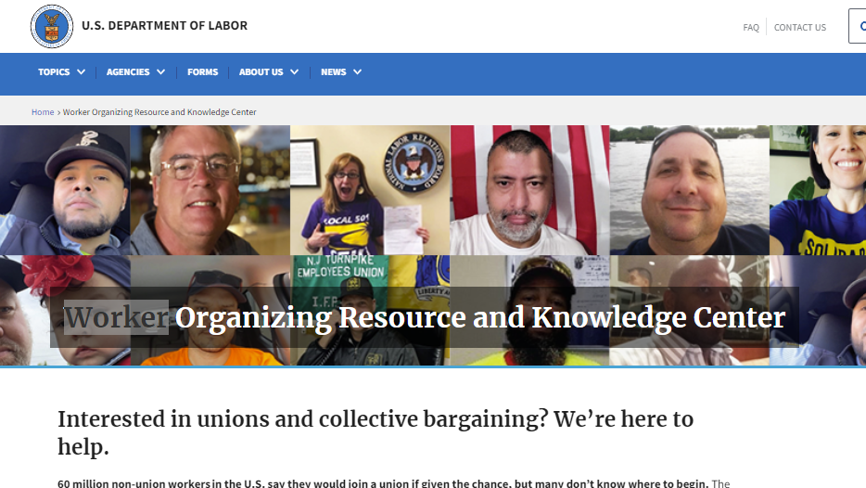
Dol.gov/general/workcenter

Slide 15
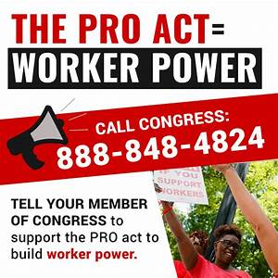
Protect the Right to Organize It’s not the law now but VERY close
Card Check elections
Bans “Captive” meetings
Monetary penalties for Unfair Labor Practices
Use of company email systems to organize
Arbitrated bargaining of 1st contract
No permanent replacement of strikers
Secondary strikes allowed
Bans Right to Work laws

Slide 16
What’s Happening The NLRB Agenda The NLRB General Counsel has outlined aggressive goals for rulemaking and case decisions that are intended to overrule precedent set by Trump-era NLRB or to ensure “employees have the right to exercise their fundamental Section 7 rights fully and freely.” MEMORANDUM GC 21-04, August 12, 2021 RE: Mandatory Submissions to Advice
NLRB Partnering with DOL, FTC and other Agencies for Cooperative Enforcement of Each Other’s Rules- NOW
Card Check Recognition (Joy Silk case)- CEMEX Version
Employer Handbook rules re recordings, confidentiality, social media, conduct
Confidentiality provisions re settlements, severance, non-disparagement- McLaren McComb Hospital
Non-competes, non-solicitation agreements restricted- Memorandum GC-23-08 (not Board ruling)
Protected Concerted Activity definition broadened
Ban on “Captive Audience Meetings”- IN PROCESS
Use of company email in organizing- IN PROCESS
Easier to prove anti-union discrimination- Lion Elastomers, Intertape Polymer Corp.
Remedies will be stronger- injunctions, financial penalties for ULPs
Union access to employer’s property- Bexar County II (off duty contractors allowed access)
Union dues protections for unions- Valley Hosp. II
Weingarten Rule expansion to non-union-IN PROCESS
Eliminate permanent striker replacement- IN PROCESS
More restrictions on employer statements re union impact on workplace and relationships with supervisors- IN PROCESS
Expansion of joint employment, narrowing independent contractor

Slide 18
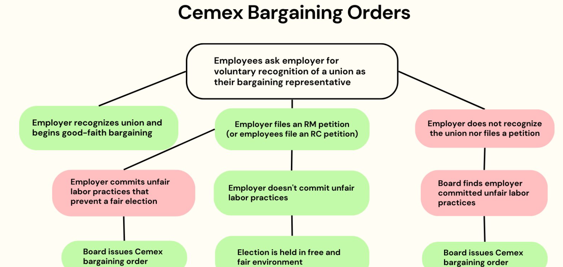

Slide 19
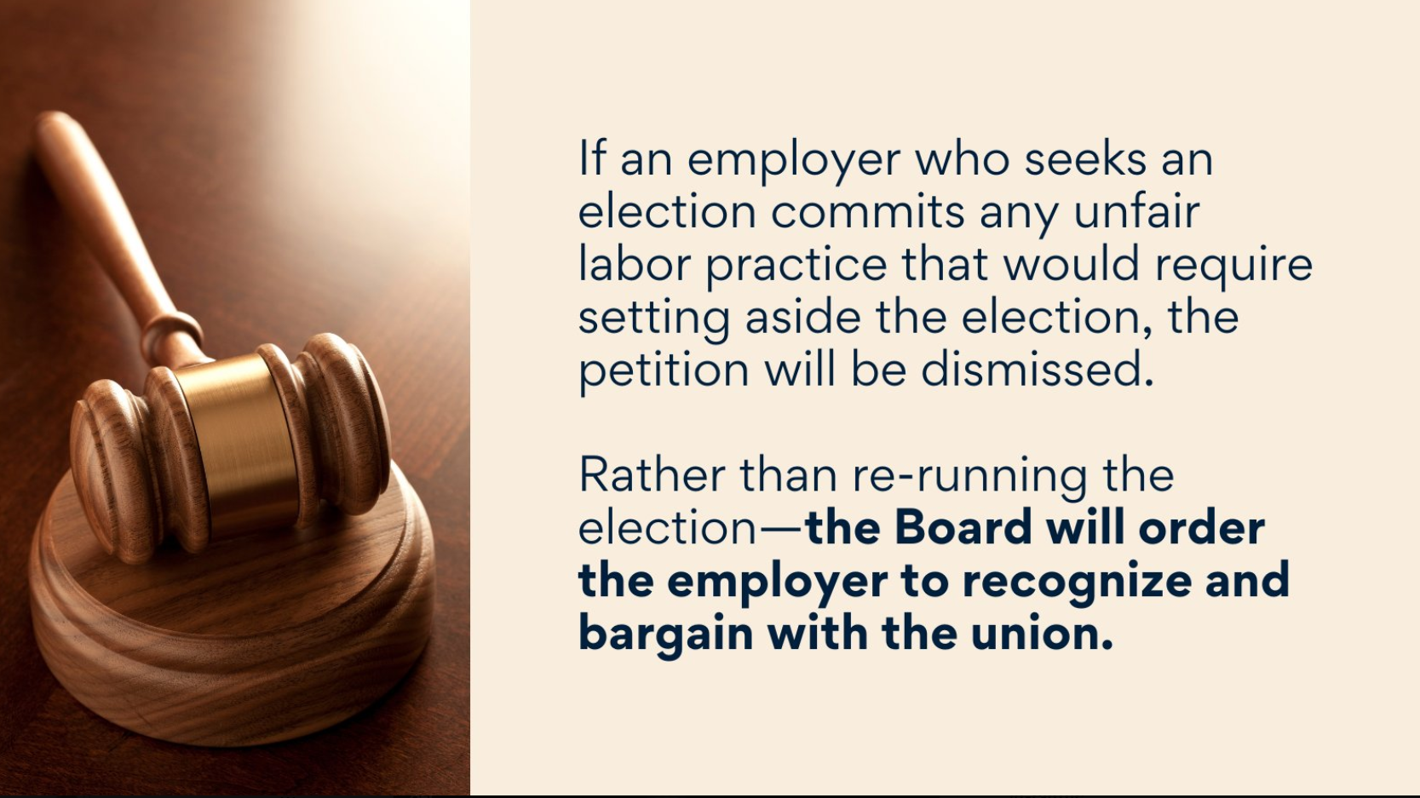

Slide 23
Days CALENDAR DAYS
-14
0
2
7
8
12³
14
24⁶
31
14 Day Cemex Period*
NEW NLRB Election Process
DDE
Request for Recognition
Election*
Post-Election Hearing (covering all pre- and post-election matters)
Optional Review by NLRB
Petition, NOH¹
Objections Due
Notice Posting
Final Employee List
Pre-Election Hearing
SOP, Prelim. Employee List
NOTES
NOH may issue after date petition filed
Pre-Election Hearing can last more than 1 day; Petitioner’s Responsive SOP due 3 business days before hearing
DDE can issue faster, but normally issues longer than 5 business days after briefs are due – 5 days is a conservative estimate
Injunction retains limits on voter eligibility issues in pre-hearing.
Injunction retains requirement that final employee list due 2 days after DDE.
Petitioner gets 10 calendar days with voting list, but can waive to get earlier election date (all other days are business days under new rule).
*14 day period may be expanded or reduced by NLRB based upon unique circumstances
NOH = Notice of Hearing
SOP = Statement of Position
RSOP = Responsive Statement of Position

Slide 24
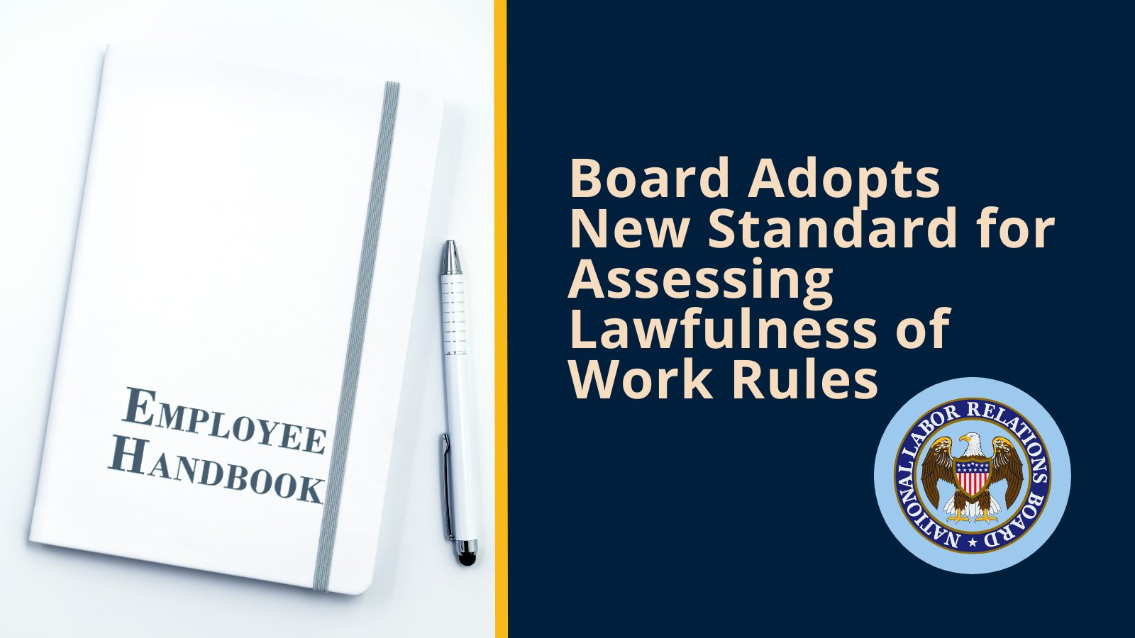

Slide 25
Employer Handbook Rules
In Stericyle (Aug. 2, 2023), NLRB moved from
Boeing (2017) balancing approach, focusing more on what the actual impact of a particular work rule has on the workplace and Sec. 7 rights
New standard builds on and revises the Lutheran Heritage Village-Livonia (2004). Focused on whether an employee could “reasonably construe” that a “facially neutral” rule was meant to restrict an employee’s Section 7 rights under the NLRA. If so, it is presumed unlawful
Impacts confidentiality rules, non-disparagement rules, social media rules, media communication rules, civility rules, respectful and professional manner rules, dress code rules, offensive language rules and no camera rules
Employer can attempt to rebut by showing the rule advances a legitimate and substantial business interest and that the employer is unable to advance that interest with a more narrowly tailored rule.

Slide 26
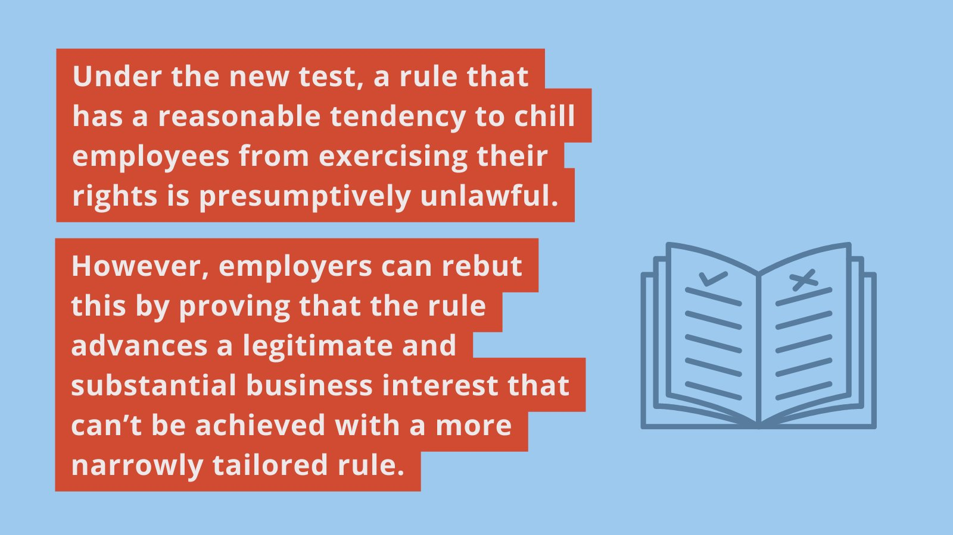

Slide 27
Protected Concerted Activity
Section 8(a)(1) of the NLRA prohibits employers from interfering with, restraining, or coercing employees who exercise their Section 7 rights, including the right to engage in protected concerted activities.

Slide 28
Expanding Boundaries
Employees’ right to act together to try to improve pay and working conditions, with or without a union. If employees are fired, suspended, or otherwise penalized for taking part in protected group activity, the National Labor Relations Board will fight to restore what was unlawfully taken away
terms and conditions of employment
pay discussions
strikes, work stoppage, walkouts
social media posts
racial and social justice discussions
buttons, pins, stickers, clothing
criticizing company, managers, supervisors
insubordinate conduct
postings
talking to government
petitions
complaining to others about conditions
raising safety concerns
cameras and recordings
asking for raises
groups complaints
refusing to work due to conditions
profanity
postings and signs
inside and outside work
One-person social media posts
Covid 19 issues

Slide 29
Protected Concerted Activity- Party of One?
Miller Plastics (Aug. 31, 2023)
The Board will consider the totality of the circumstances before and after an individual employee’s conduct to determine whether the conduct can be considered:
an act to bring a group complaint to the attention of management, or
to make an explicit or implicit call to group action
Termination of individual employees engaging in such conduct violates the NLRA.

Slide 30
MCLAREN MACOMB HOSPITAL DECISION
Mere offer violates 8(a)(1)
Confidentiality, nondisclosure and non-disparagement provisions in severance agreement
Ability to discuss terms of these agreements necessary for Section 7 rights of signer and coworkers
Will be appealed; in the meantime
Review severance language carefully with counsel; narrowly tailor
How important to each settlement?
Disclaim Section 7 impact; severability
What about right to refrain? (SPOILER: not mentioned)

Slide 31
Confidentiality Provisions- Severance and Settlement Agreements
GC Memo GC-23-05 (March 22, 2023)
McLaren Macomb applies retroactively
Applies to any offer of an agreement including confidentiality, non-disclosure or non-disparagement provisions within prior 6 months
Applies to any enforcement of severance agreement within prior 6 months (even if entered more than 6 months prior)
Effectively outlaws ALL confidentiality, non-disclosure or non-disparagement provisions no matter when entered
Applies to severance agreements with 2(11) supervisors, if supervisor claims reason for termination includes refusal to engage in an unfair labor practice

Slide 32
Discussions of Racism, Social Issues in Workplace
GC Advice Memo issued February 27, 2023
Employee discussions of certain "vital categories of workplace life," such as racial issues, may render the discussions inherently concerted (and therefore protected under the NLRA) even if group action is not yet contemplated
In this regard, such discussions may be viewed as protected concerted activity, irrespective of whether other employees agree with the message or join in the employee's cause.
“Legitimate business reasons” such as avoiding controversy, tension and conflict in the workplace likely will not justify “retaliatory action” by an employer

Slide 33
Dress Code
In Tesla (8/29/22), NLRB ruled 3-2 that Tesla’s “Team Wear” policy requiring black t-shirts (plain or with Tesla logo), violated s. 7 rights when Tesla prohibited employees from wearing union logo on their black shirts
“any attempt to restrict the wearing of union clothing or insignia is presumptively unlawful and – consistent with Supreme Court precedent – an employer has a heightened burden to justify attempts to limit this important right”
Employer "has the burden to establish special circumstances" and the majority found that “Tesla failed to establish special circumstances in this case.“
Overruled Walmart (2019) justification for restricting union insignia on the selling floor to enhance the customer shopping experience and prevent theft or vandalism.

Slide 34
Profanity
In Lion Elastomers (May 1, 2023), the NLRB overruled the General Motors (2020) “balancing of interests” test, and returned to the former “setting-specific” standard that protects employees disciplined or discharged for misconduct that occurs during activity otherwise protected by the National Labor Relations Act
This case involved an employee who was terminated for being extremely disruptive, profane and offensive during safety meetings and strike activity
This ruling allows employees substantial leeway and protects intemperate outbursts and other abusive conduct if they occurred in the context of an employee exercising Section 7 rights
In Lion Elastomers, the dissenting board member cited several examples of outrageous, abusive, discriminatory and profane conduct that were protected by pre-General Motors cases and expressed concern that discriminatory and abusive employee conduct would be encouraged and tolerated

Slide 35
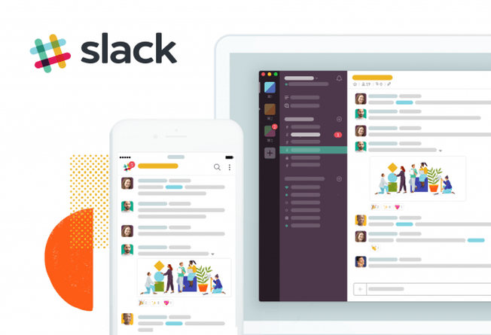
Greater Access to Employer Comms/Property
Current: Rio All-Suites Hotel and Casino (2019) restricts employees’ use of email systems to workplace communications
NLRB Objective- Return to Purple Communications standard allowing company email to be utilized for union organizing communications
Address use of Discord, Slack, Groupme and other employer communication systems
NLRB also seeks to clarify and possibly overrule prior cases allowing enforcement of non-solicitation policies and allow broader union solicitation in the workplace and access to employer’s private property

Slide 36
Joint Employer Status
Through its rulemaking authority, the NLRB seeks to return to the Browning-Ferris standard that was overturned by Trump-era NLRB rulemaking.
Joint Employment- Two or more separate entities “share or codetermine” essential terms and conditions of employment, e.g., decisions about hiring, firing, disciplining, supervision, and direction of employees
Typically, contractor/subcontractor relationships, temporary or contract staffing, professional employment organizations, parents/subsidiaries and franchisor/franchisee
Browning-Ferris broadens the test and makes it easier for employees to be considered as employees of more than one employer.
Does not require that an employer exercise “actual control” over an employee, just that they “share or codetermine” essential job terms, such as wages, benefits, discipline, and hiring.
Overturns Trump-era rulemaking requiring direct and immediate control
Impact?
Possible duty to participate in collective bargaining;
Joint or independent responsibility for unfair labor practices committed by either employer;
Significant impact on franchisors, PEOs, staffing services, joint venturers, general contractors
NATIONAL LABOR RELATIONS BOARD
29 CFR Part 103
RIN 3142-AA21
Standard for Determining Joint-Employer Status
AGENCY: National Labor Relations Board.
ACTION: Notice of proposed rulemaking; request for comments.
SUMMARY: This notice of proposed rulemaking (NPRM) proposes to rescind and replace the final rule entitled “Joint Employer Status Under the National Labor Relations Act,” which was published on February 26, 2020 and took effect on April 27, 2020. The proposed rule would revise the standard for determining whether two employers, as defined in section 2(2) of the National Labor Relations Act (NLRA or Act), are joint employers of particular employees

Slide 37
Definition of Employee vs. Independent Contractor
In Atlanta Opera (June 20, 2023), the Board overruled Trump-era policy and returned to the prior standard
Used a new (old), narrower test considering a multitude of factors when assessing employee status, with no one factor being decisive
The Trump Board afforded special weight to a worker’s entrepreneurial opportunity for profit or loss – this factor is now simply one of many, which are not singularly decisive.

Slide 38
Weingarten Rights Expansion
Current: No right for employees to have anyone else present for disciplinary interviews/investigations
NLRB Objective: Apply Weingarten principles in non-unionized settings as enunciated in IBM Corp., 341 NLRB 1288 (2004). Would allow employees to have a representative present for disciplinary proceedings

Slide 39
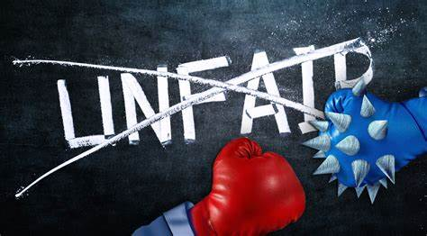
Stronger Remedies for ULPs
Injunctions- Greater use of Section 10(j) injunctions. Emphasis on
Cases involving discharge during a union campaign
Where board believes employer’s actions will lead to unfair election
Bad faith bargaining, refusal to bargain
Unlawful withdrawal of recognition of union; successor refusal to bargain or hire
Extended Remedies- NLRB will seek non-traditional remedies beyond lost pay/benefits.
Could include compensation for healthcare expenses after losing health insurance; money to cover credit card late fees; or the loss of a home or car that results from an unlawful discharge
PRO Act provides for punitive damages. The Build Back Better bill provides for personal liability for corporate officers for NLRA violations- Neither have passed the Senate

Slide 40
TRI-CAST ADVICE MEMOS Can You Refer to Direct Relationship?
On 1/30/23, GC Abruzzo re-issued 4 Advice Memos arguing NLRB should overturn Tri-Cast, Inc., 274 NLRB 377 (1985)
Before Tri-Cast, misrepresenting 9(a) right to adjust grievances directly violated 8(a)(1), objectionable pre-election conduct.
In Tri-Cast, Board allows employer to say informal person-to-person relationship “will change,” and things will be run “by the book, with a stranger” and employer “will not be able to handle personal requests as we have been doing.”
Finds no threat to take away an existing benefit, only explained view that relationship with the employees would change if they unionized.
Because 9(a) contemplates changes to the employer-employee relationship, not a threat to withdraw existing benefits but merely recognition relationship would “not be as before.”

Slide 41
TRI-CAST ADVICE MEMOS Can You Refer to Direct Relationship?
The following employer statements would most likely be unlawful under the Tri-Cast memos
“There would be no direct contact allowed between supervisors, managers and employees.”
Employees “could no longer come to HR or the plant manager and talk to them about your problems, you would only be allowed to do that through a union representative.”
“You can't just come to me as your manager anymore. You have to go to your union rep.”
If you sign a union card, “you'll be giving up your right to speak for and represent yourself.”
If you sign a union card, “you no longer have a voice, you've signed that away to some third party.”
“Everything would be filtered through the union.”
“The number one difference with a unionized environment is that you will not have the pleasure of working with me or management directly. You will have to go through the union to have a relationship with us.”

Slide 42
Other Case Review Outlined in the GC Memo
Cases allowing permanent replacement of economic strikers (currently allowed)
Cases involving intermittent strikes (not currently protected)
Cases involving secondary strikes (not currently protected)
Cases allowing employers to offer replacement workers superior terms to those offered striking employees (currently allowed)
Cases preferring deferral to arbitration on claims alleging ULPs (currently allowed)
Cases restricting remedial measures (esp. when employee waives reinstatement in exchange for cash settlement)
Cases limiting NLRB jurisdiction over religious institution employers (NLRB wants them classified as “employers” and employees able to unionize under the Act)
Cases that broaden management rights under a CBA or after expiration of CBA
Cases that protect employers who engage in “surface bargaining”

Slide 43
It’s Real. It’s Here. Be Aware. Be Prepared.

Slide 44
Practical Steps Employers Should Take Now
Maintain atmosphere of trust and open communication with your workforce.
Prioritize employee engagement, manager approachability
Scrutinize policies, procedures, severance agreements for potential Sec. 7 interference, ULPs
Address lingering workplace issues and ensure that restrooms, breakrooms and locker rooms are clean and operational (“low-hanging fruit”)
Train managers and Supervisors on how to recognize and respond to signs of union organizing, protected concerted activity
Have a response plan and a communications strategy in the event PCA or union organizing activity takes place
Rules are complex and timing is critical

Slide 45
Questions?

