Slide 1


Marijuana and the State of Alabama
Presented by:
Tae Phillips Ogletree, Deakins, Nash,
Smoak & Stewart, P.C.
tae.phillips@ogletree.com
205-714-4409 (Direct Dial-Office)
205-281-8849 (Cell)

Slide 2
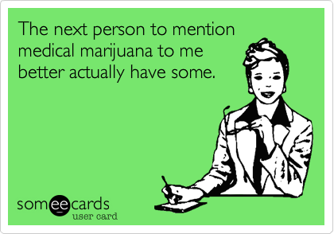
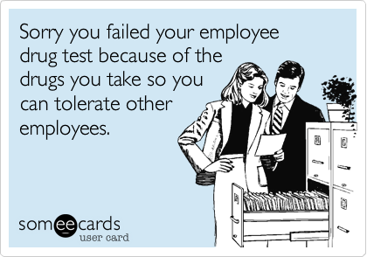
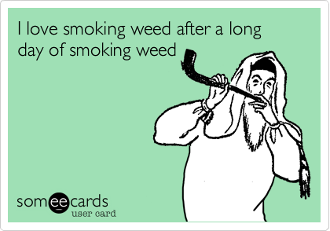
A Day in the Life

Slide 3
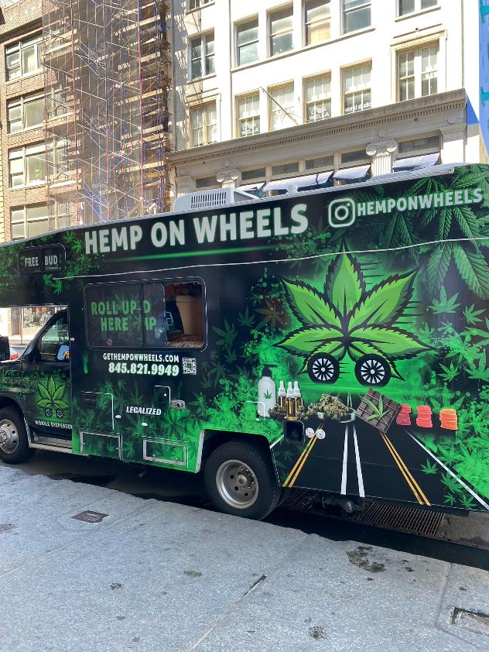
Coming Soon to a Street Near You!

Slide 4
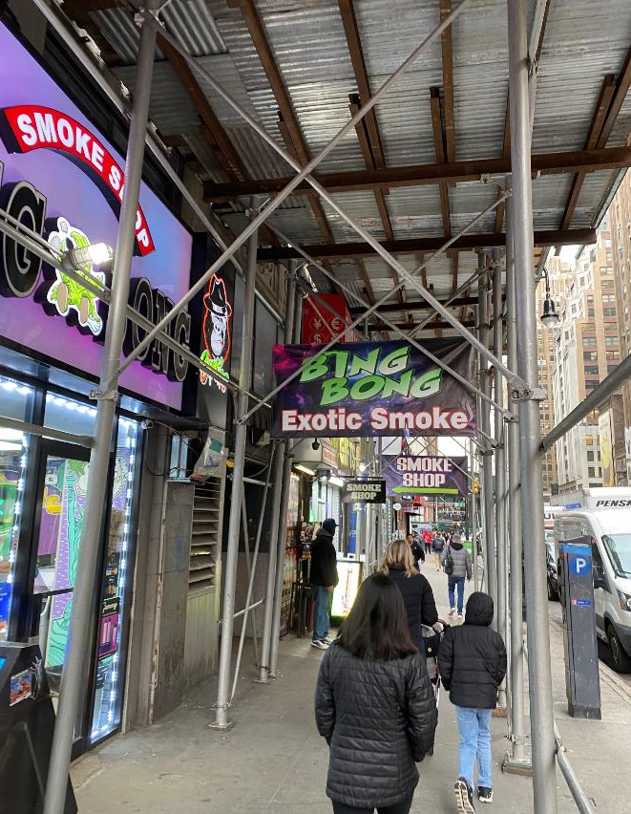
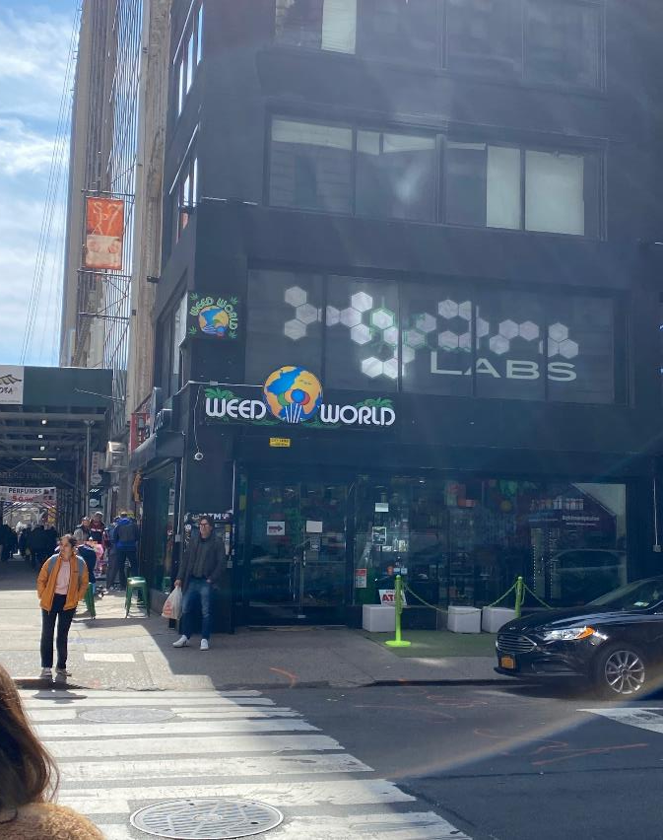
Coming Soon to a Street Near You!

Slide 5
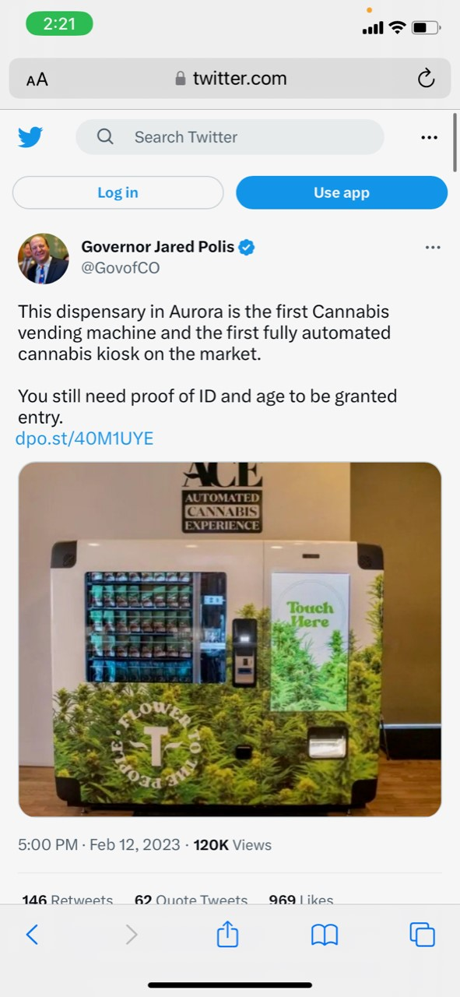
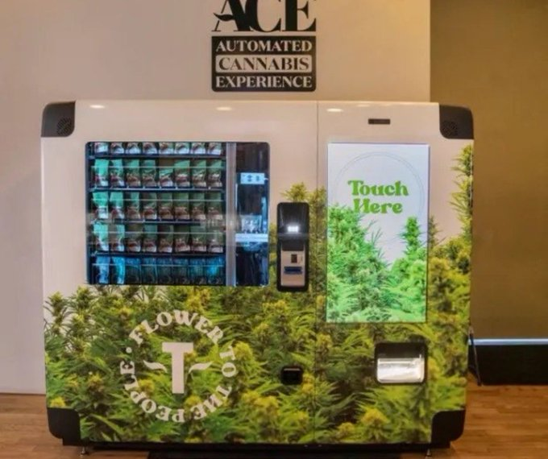
Coming Soon to a (Hallway?) Near You!

Slide 6
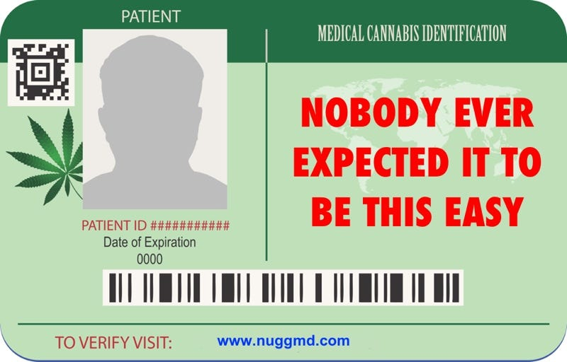
Coming Soon to Your Workplace (Part 1)

Slide 7

Coming Soon to Your Workplace (Part 2)

Slide 8

Agenda
Recap: Marijuana 101
Alabama’s (Not So) New Medical Marijuana Law
Policy Considerations and Strategies
Employer Action Items

Slide 9
Marijuana in the Workplace 101
Four Things to Remember:
  1. Marijuana Laws are Very State Specific
  2. Marijuana Laws Change Often
  3. Marijuana in the Workplace: Broader and More Complicated Than You Think
  4. Marijuana in the Workplace: Sometimes it is Misleading

Slide 10
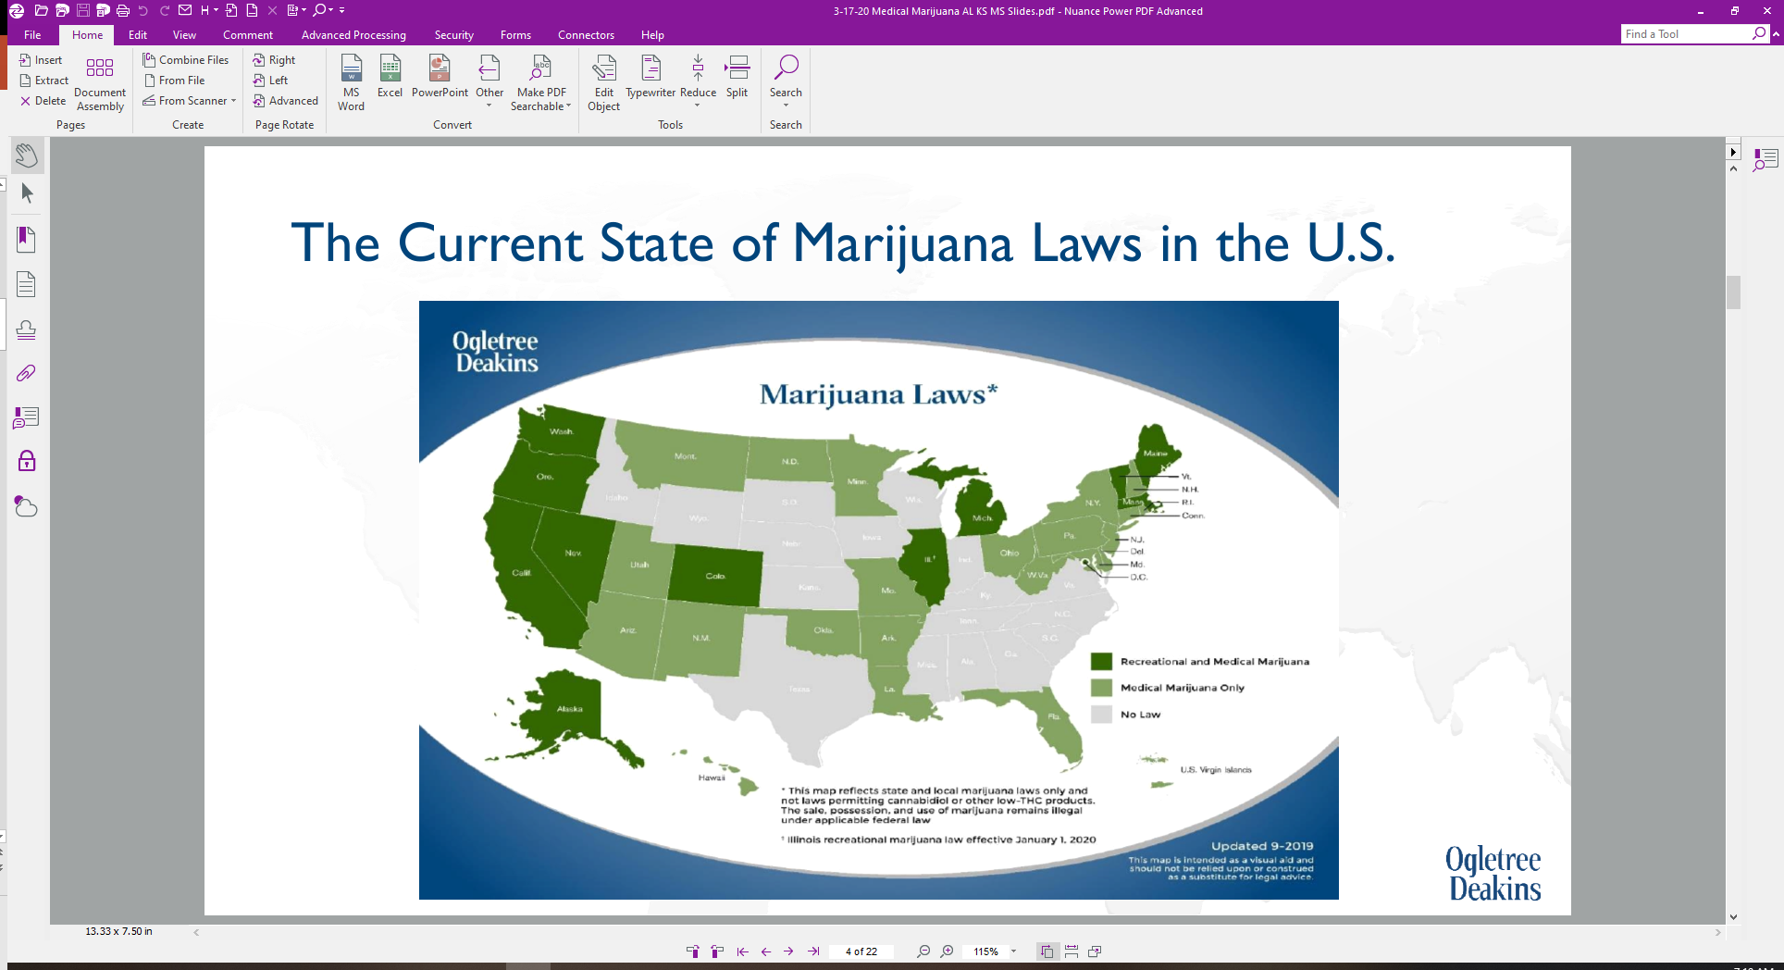
Marijuana in the Workplace 101:
The Laws are State Specific…and Change Often
Note: This map was current as of September 2019.

Slide 11
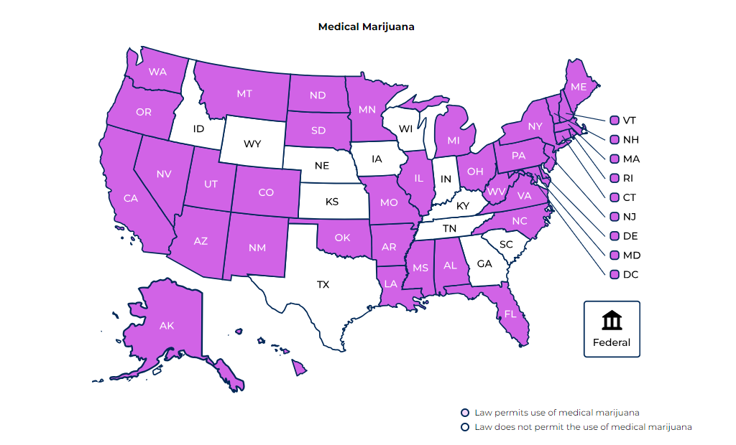
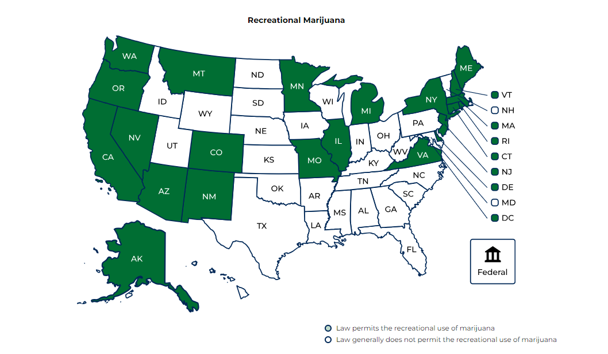
Marijuana in the Workplace 101:
The Laws are State Specific…and Change Often

Slide 12







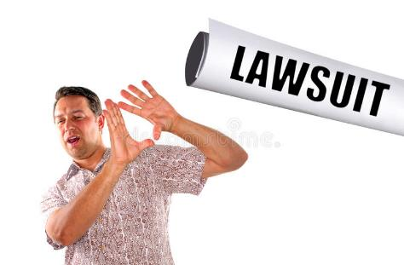
Marijuana 101 - So Complicated (it will make you want to Burn One Down)

Slide 13
What War on Drugs? 2017 >> 2023
Medical Marijuana – New Laws
Medical Marijuana – Amended Laws
Recreational Marijuana – New Laws
Medical and Recreational Marijuana – Lawful Off-Duty Conduct Laws
Pre-Employment Testing Restrictions

Slide 14

Clearing the Smoke (a/k/a Mythbusting)
Isn’t Marijuana Illegal Under Federal Law?
If I am a Government Contractor, I’m Shielded by the Drug Free Workplace Act?
What about Federal Regulations Like DOT Drivers?
Doesn’t OSHA Require Us to Keep the Workplace Safe?
Marijuana is Impairing, Right?
“Cardholder” v. Prescribed

Slide 15

What Does the AL Medical Marijuana Law Say?
No Employment Protections for Medical Marijuana Cardholders (within the Medical Marijuana Law Itself)
Possible Disability Discrimination or Disability Accommodation Issues?
  Medical Marijuana Cardholder Status = Qualifying Medical Condition = Disability
    AL does not have a state disability discrimination law and, instead, would be governed solely by the Americans with Disabilities Act of 1990
Does Not Allow for Smoke-able Forms of Marijuana or Marijuana-Infused Food Products
  Only oils, creams, patches, pills, lozenges, etc.

Slide 16

What Does the AL Medical Marijuana Law Say?
Employer-Friendly Language – The Medical Marijuana Law Does Not:
  Require employers to permit, accommodate, or allow the use of medical marijuana
  Require an employer to modify job or work conditions for applicants or employees who use medical marijuana
  Prohibit employers from establishing and enforcing drug testing, drug-free workplace, etc. policies
  Prohibit employers from requiring medical marijuana cardholders to notify employers of medical marijuana cardholder status
  Interfere with federal regulations or restrictions, such as DOT regulations
  Provide for an express, legal cause of action for an individual to file a claim against an employer for taking adverse employment action due to medical marijuana use

Slide 17

How Will Courts Interpret the AL Medical Marijuana Law? What Should Employers Be Worried About?

Slide 18

Medical Marijuana and Disability Issues?
Qualifying Medical Conditions (Alabama)
  Autism Spectrum Disorder
  PTSD
  Crohn’s Disease
  Epilepsy
  Depression
  “Any Condition” Causing Chronic Pain (where other treatments or opioid therapies have been ineffective)
  Others

Slide 19
Medical Marijuana and Disability Issues?
“Disability” (ADA definition)
  A physical or mental impairment that substantially limits one or more major life activities
  A person who has a history of a physical or mental impairment that substantially limits one or more major life activities
  A person who is perceived by others as having a physical or mental impairment that substantially limits one or more major life activities

Slide 20

(Real Life) Case Study

Slide 21
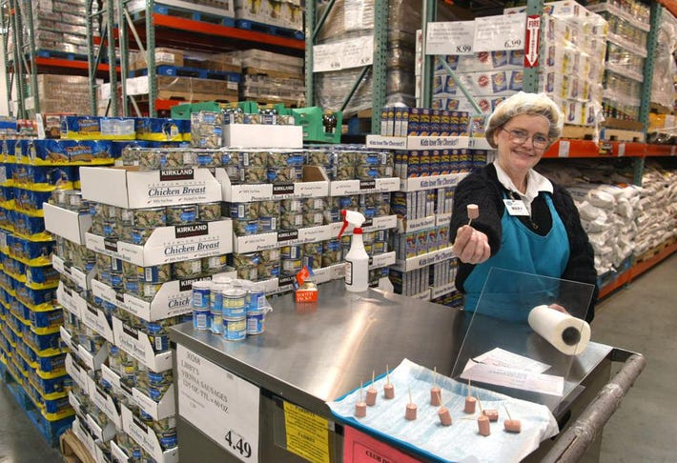
(Real Life) Case Study

Slide 22

(Real Life) Case Study

Slide 23
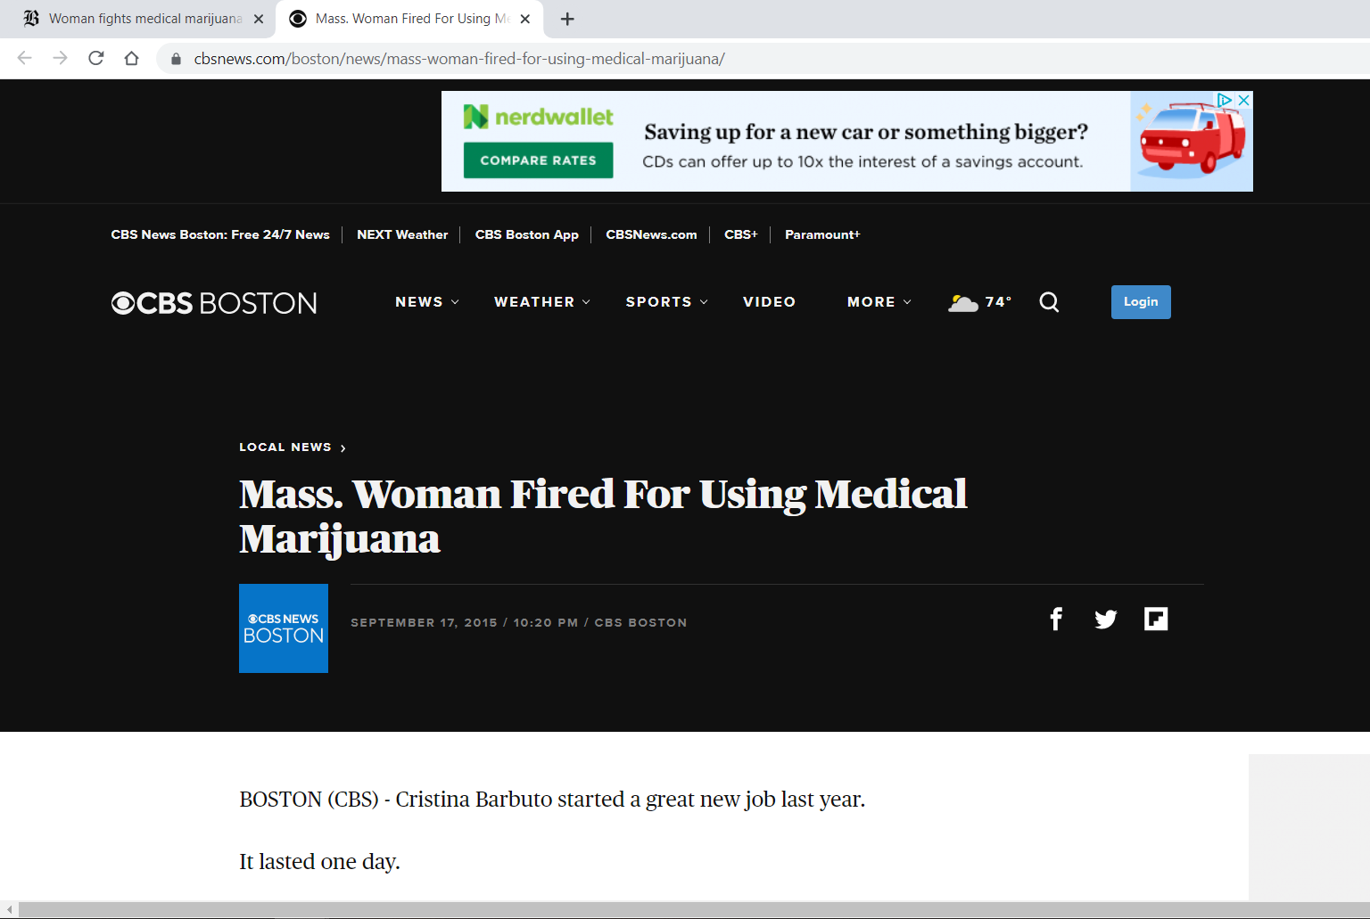
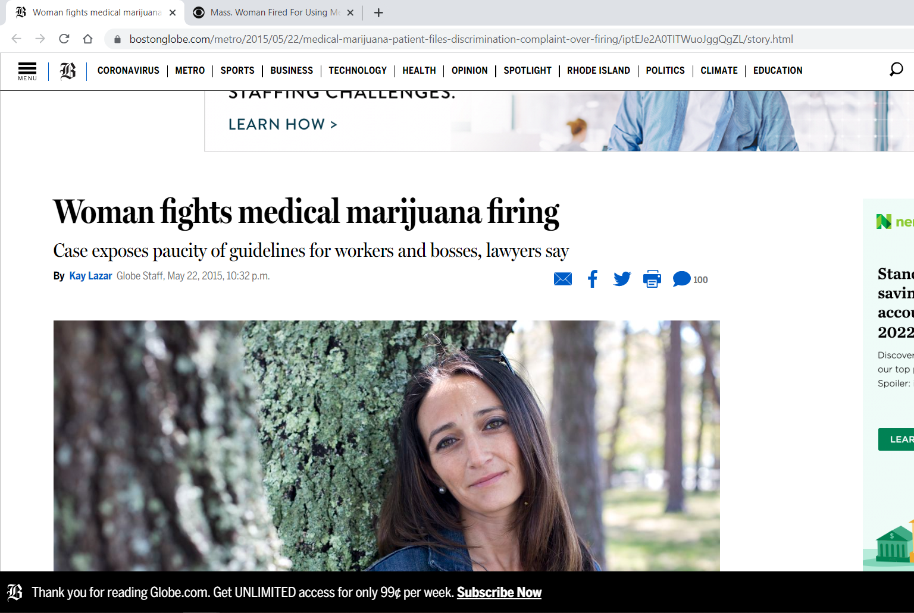
(Real Life) Case Study

Slide 24
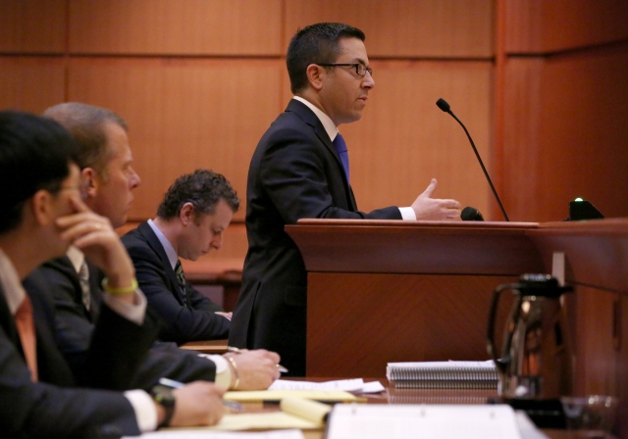
(Real Life) Case Study

Slide 25

All Right, All Right, All Right…. What’s the Solution?
First:

Slide 26
All Right, All Right, All Right…. What’s the Solution?
Do we want to test for marijuana at all?
Do we want to test only certain categories of employees?
Do we want to test only in certain circumstances?
How “zero tolerant” do we want to be?
How are we going to handle accommodation issues?

Slide 27
All Right, All Right, All Right…. What’s the Solution?
Action Items:
  What do you want to do about marijuana? Figure that out first, taking into consideration company culture, safety, risk avoidance, recruiting and retention, etc.
  Review your drug (and alcohol) testing / drug-free workplace policy. Does it need to be tweaked?
  Regardless of policy revisions, develop an internal protocol and procedure for dealing with marijuana issues in the workplace.
  Figure out a way to stay on top of the ever-changing marijuana legalization laws, court decisions interpreting those laws, and other legal issues at play (e.g., disability discrimination, lawful off-duty conduct laws).

Slide 28
All Right, All Right, All Right…. What’s the Solution?
Action Items:
  Review your job descriptions and ensure that safety-sensitive jobs are being classified properly.
  Train your supervisors and managers in recognizing impairment and how to document impairment.
  Develop a reasonable suspicion checklist.
  “Learn” the topic of marijuana and the workplace as best you can. (It will help to diagnose issues as they arise).

Slide 29


Slide 30
Thank you!
Tae Phillips
Ogletree, Deakins, Nash, Smoak & Stewart, P.C.
420 20th Street North, Suite 1900 | Birmingham, Alabama 35203
tae.phillips@ogletree.com
Phone: 205.714.4409 (Office) / 205.281.8849 (Cell)

